Slide 1
Python Chapter 6

Slide 2
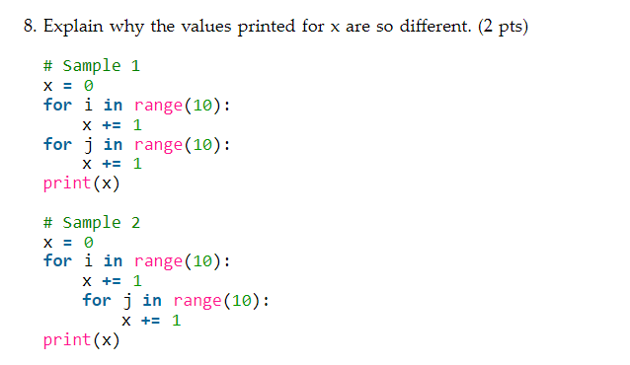

Slide 3
Chapter 6 Lab Task 6

